Slide 1
Metabolomics Update
13/10/23

Slide 2
Approach
Inoculations staggered to calibrate symptom development.
Samples collected and images taken:
Sampling time points:
7 dpi; Xvm, Dro
15 dpi; Foc
10 dpi; Xvm, Dro
18; dpi Foc
13;dpi; Xvm, Dro
21 dpi, Foc

Slide 3
Disease Progression; Symptom score
Error bars == standard deviation
External symptoms – percentage of yellowing/wilting leaves –scored following a 1–4 scale: 1 = 0 > x ≤ 25%, 2 = 25 < x ≤ 50%, 3 = 50 < x ≤ 75%, and 4 = 75 < x ≤ 100%.
Internal symptoms – plants cut longitudinally at the rhizome. Disease severity was visually assessed 1–6 scale: 1 = No discoloration in the corm, 2 = isolated points, x < 5%, 3 = 5 < x ≤ 30%, 4 = 30 < x ≤ 50%, 5 = 50 < x ≤ 90%, and 6 = plant totally decayed x < 90%
García-Bastidas, F.A., Van der Veen, A.J., Nakasato-Tagami, G., Meijer, H.J., Arango-Isaza, R.E. and Kema, G.H., 2019. An improved phenotyping protocol for Panama disease in banana. Frontiers in plant science, 10, p.1006.

Slide 4
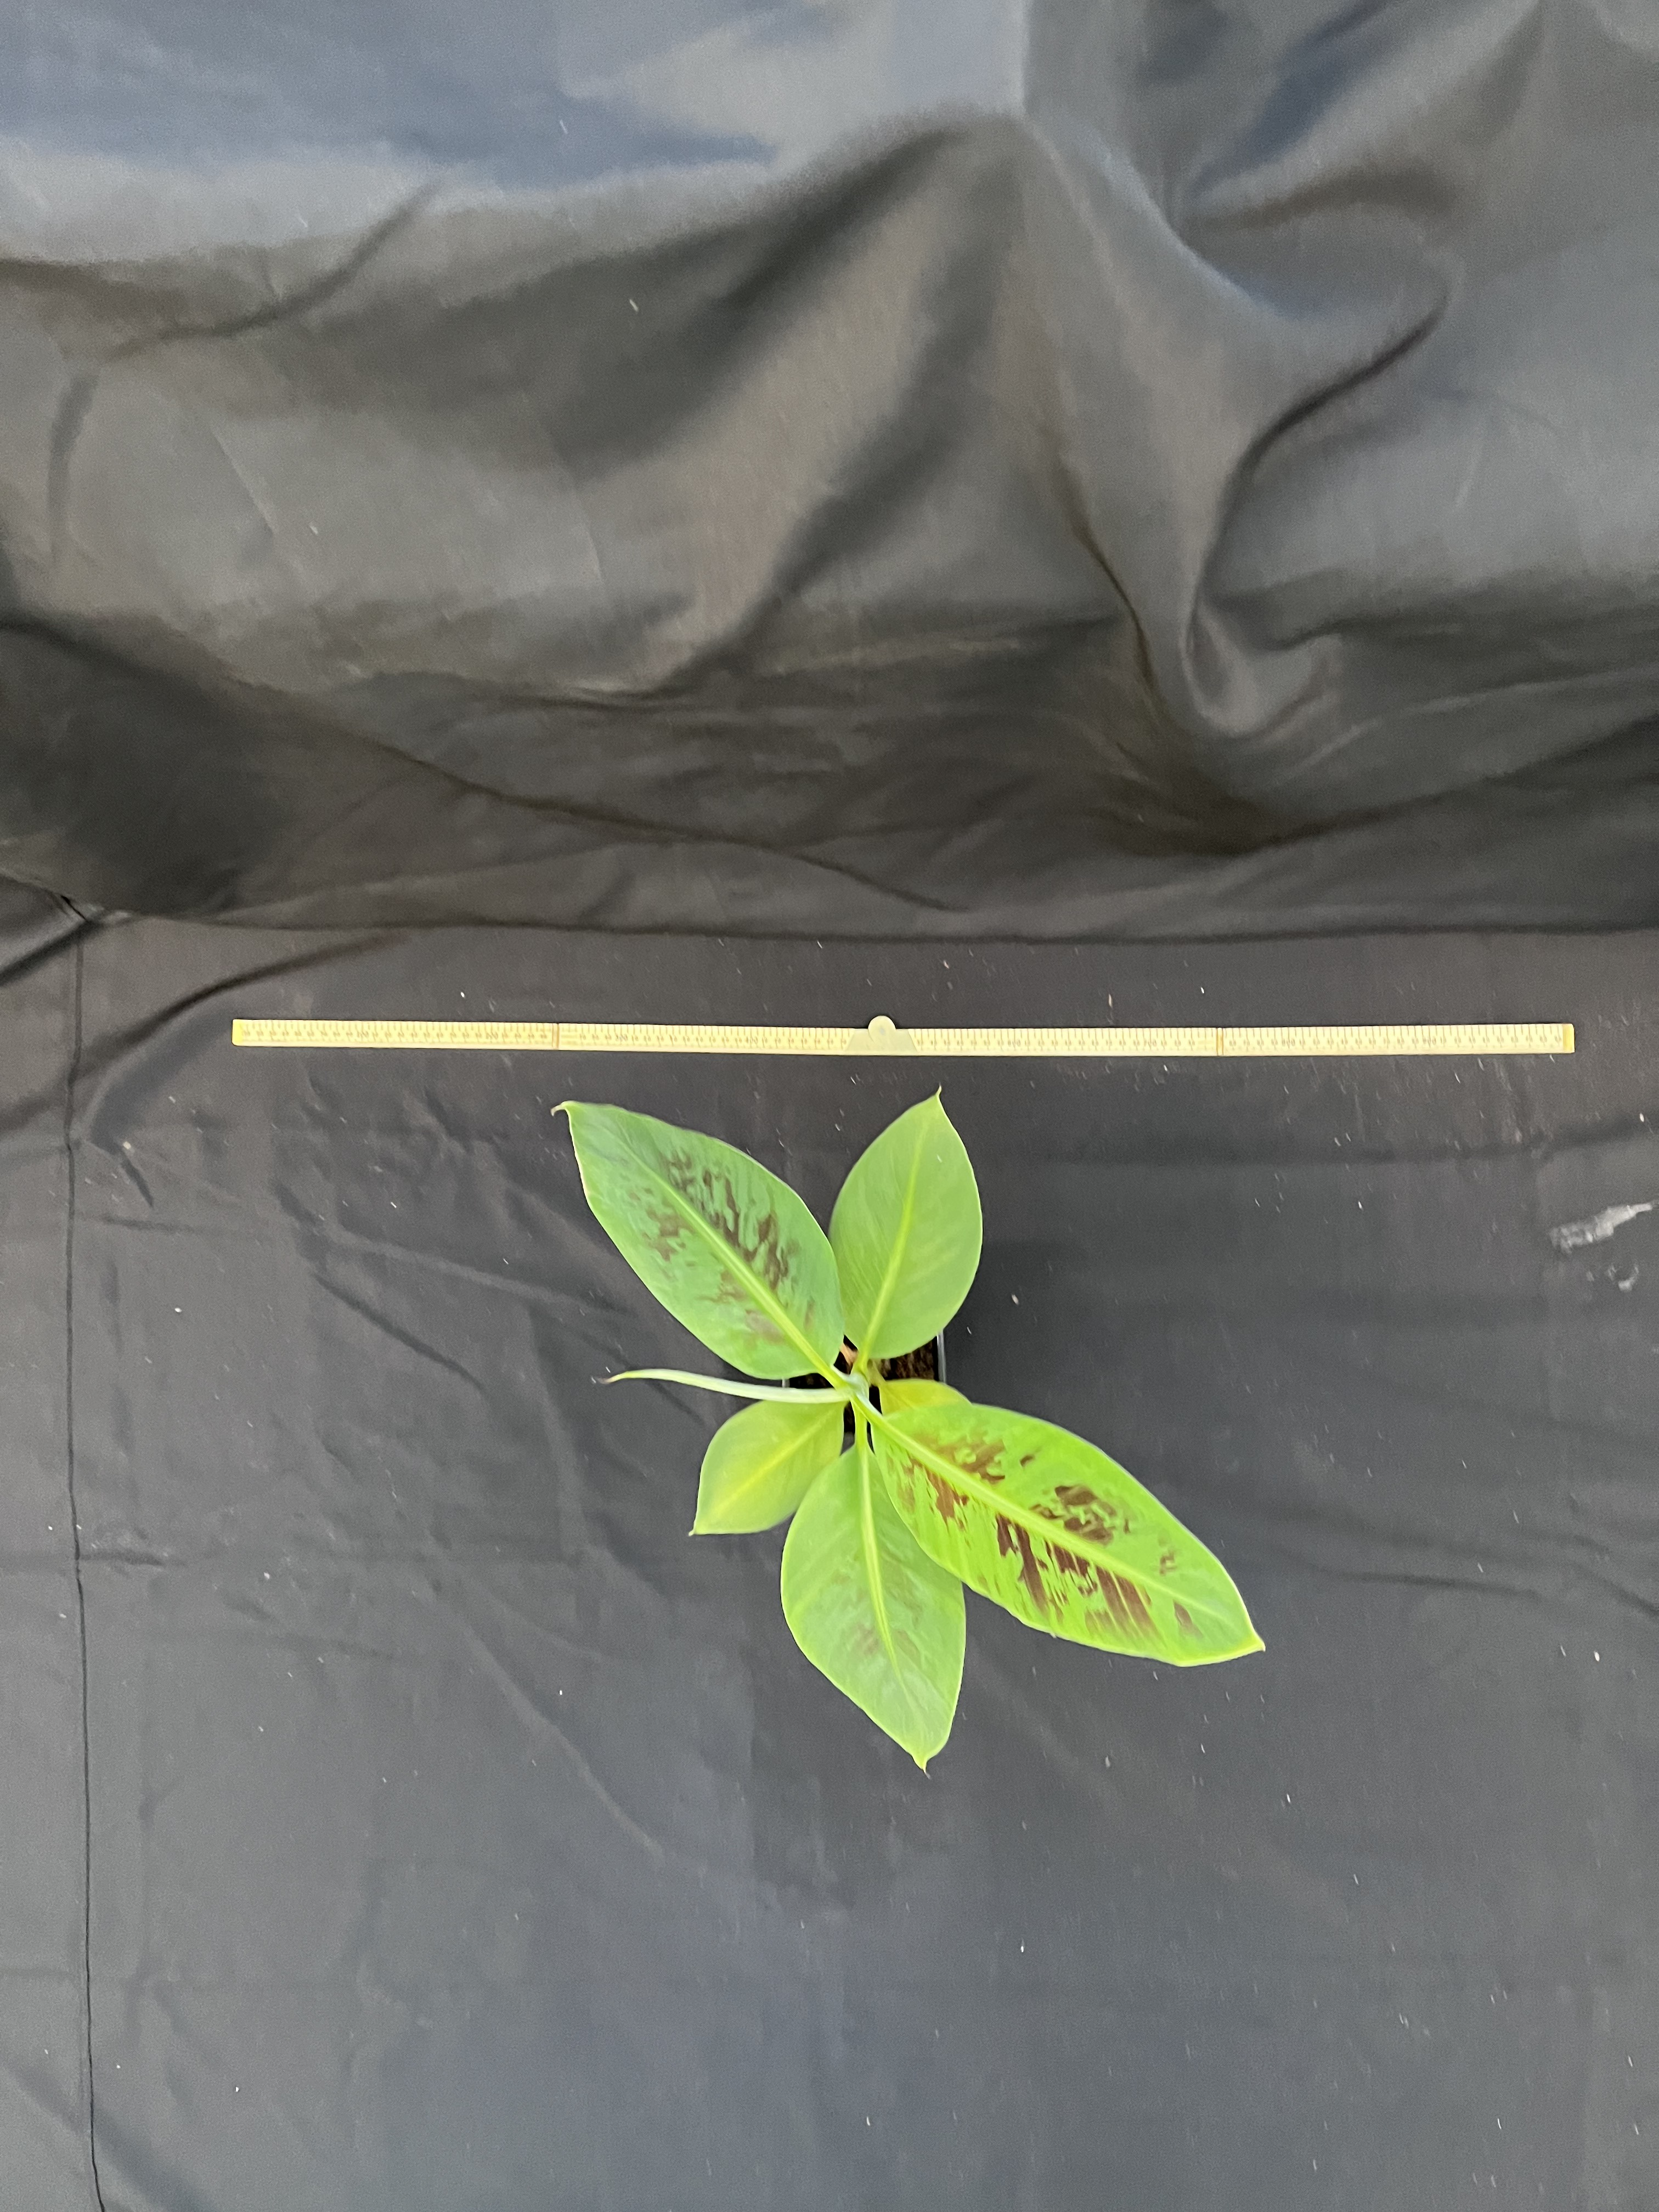
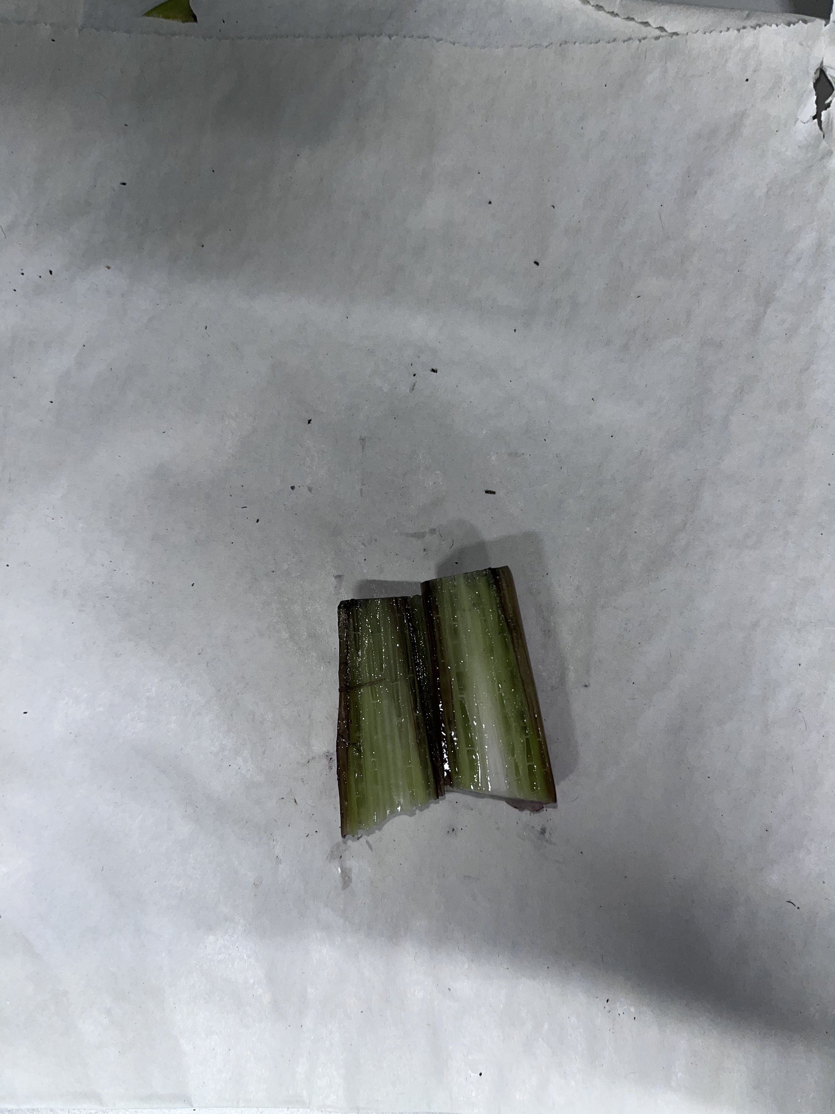
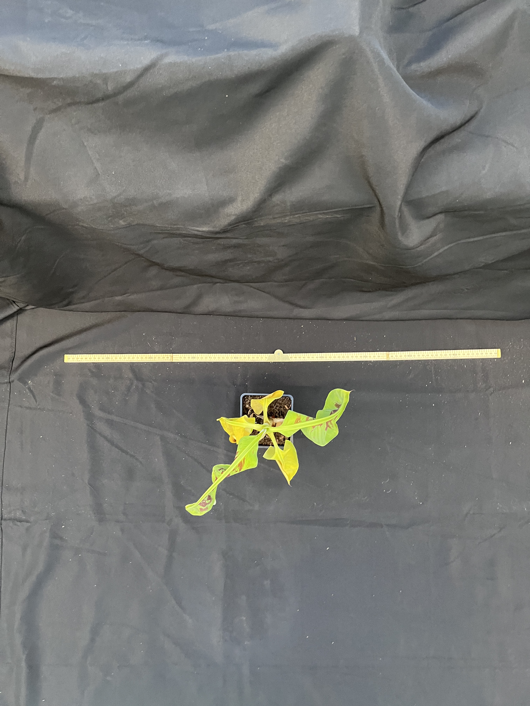
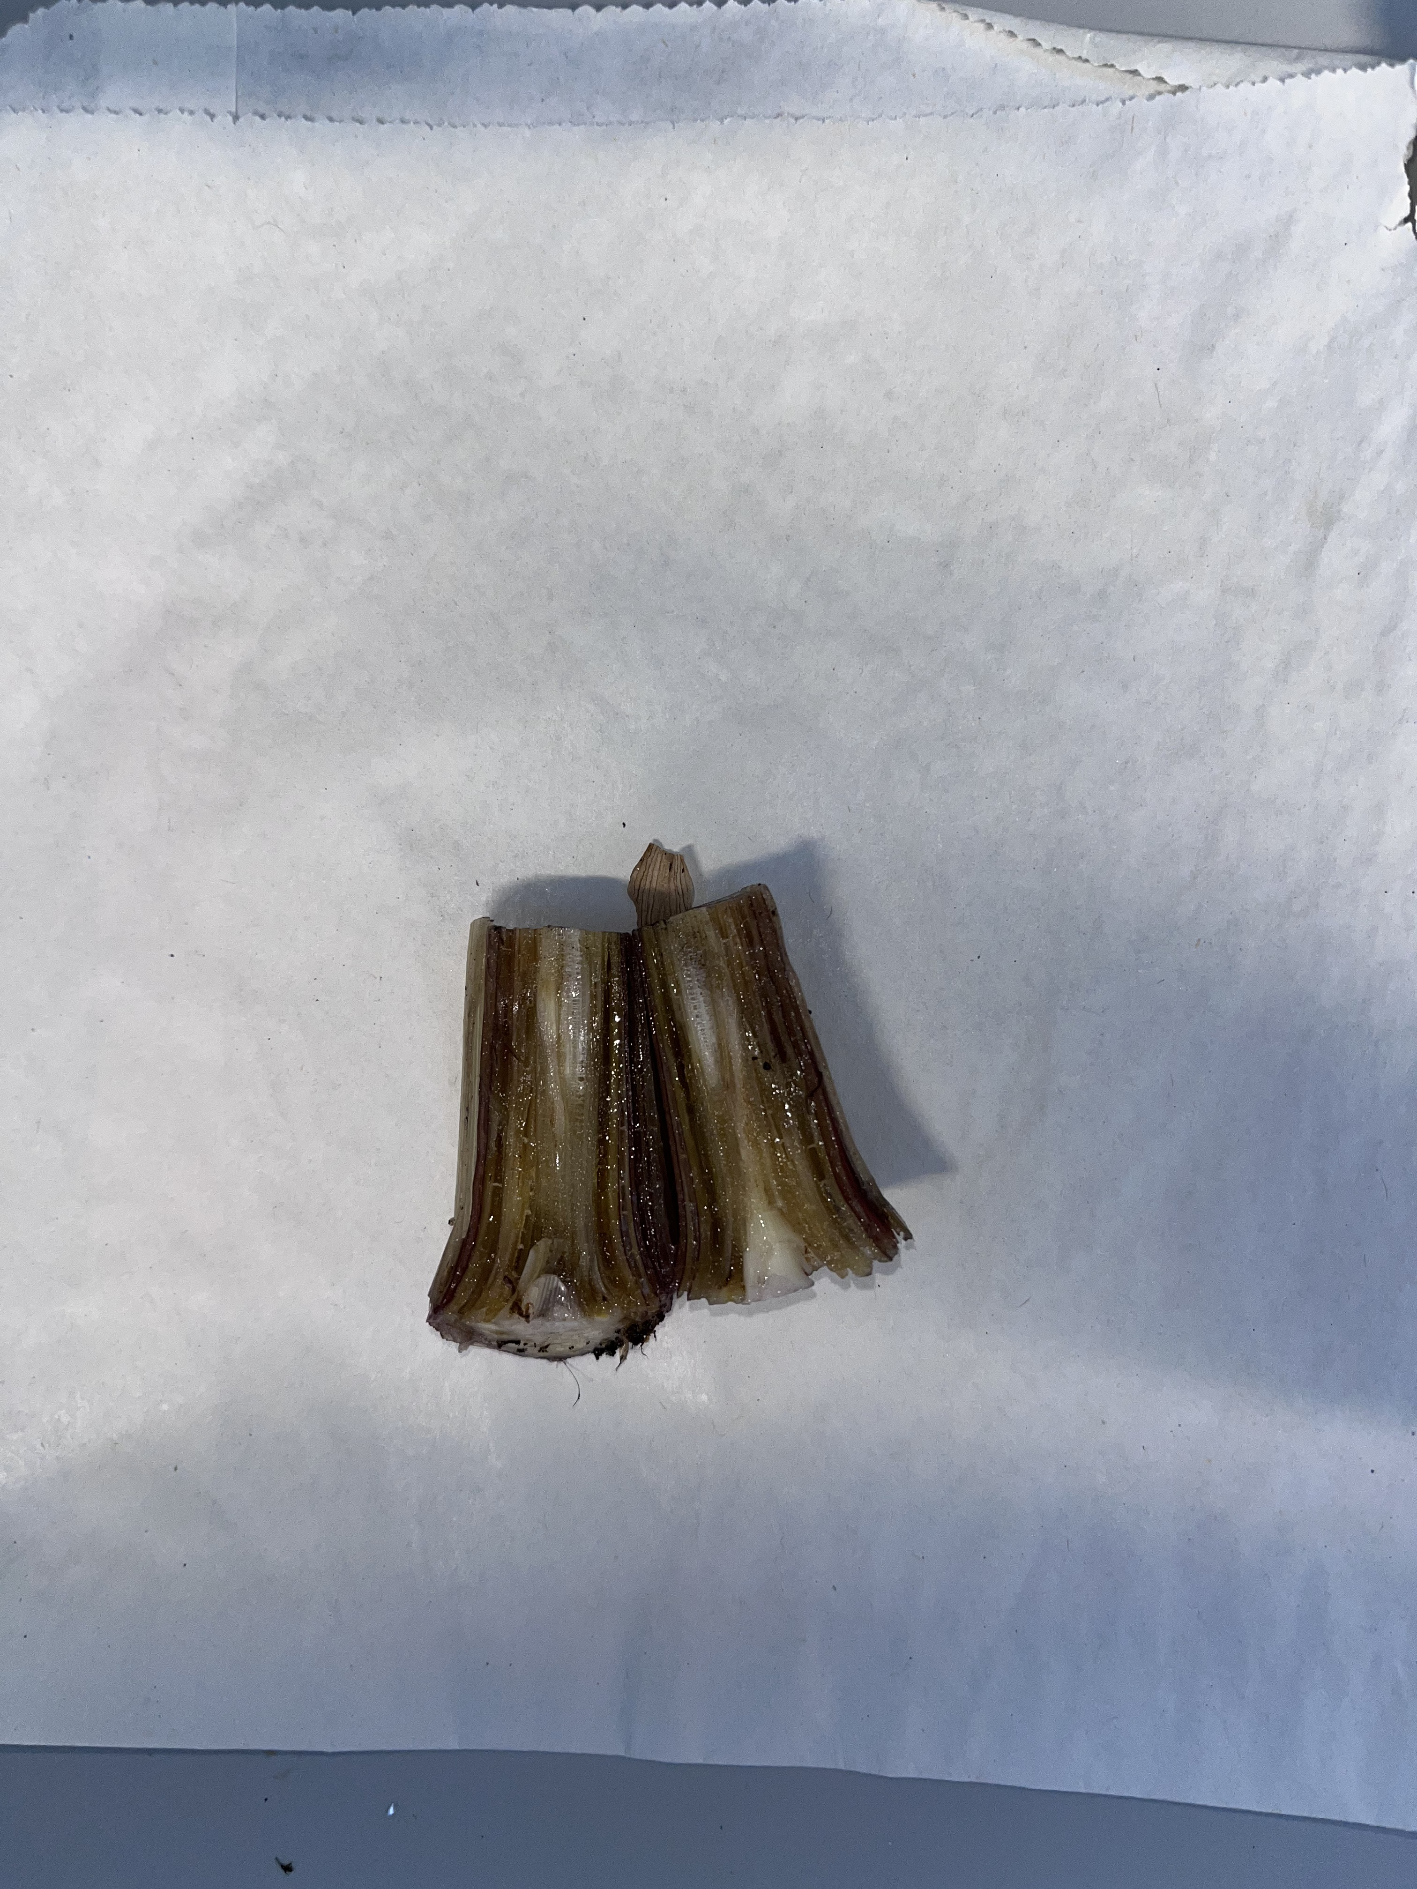
Example control;
Time Point 3
Example Xanthomonas;
Time Point 3

Slide 5
Contamination in Blank
Last Sample in run
First Sample in run

Slide 6
Overview of data – identify outliers from raw IPO settings
Outliers == C9-1 , C12-2,C12-3, X12-4, C15-1, Blank_1, Blank_2
LOW
HIGH
No obvious pattern - interesting the samples are in pairs in XCMS output…

Slide 7
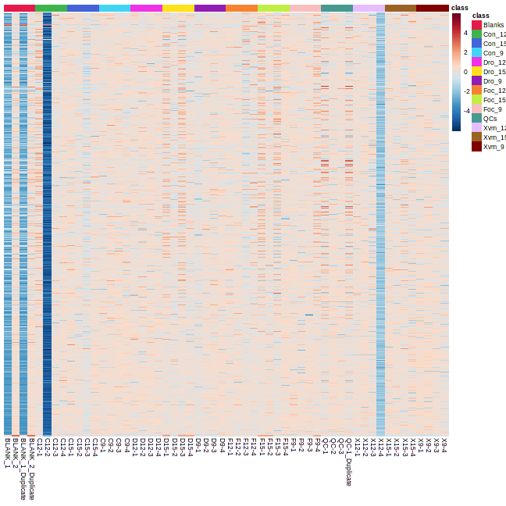
Heatmap of IPO Basic data filtering
Outliers == C9-1 , C12-2,C12-3, X12-4, C15-1, Blank_1, Blank_2
If we look at the run order
Blank 1 == first sample
C12-2 == Second sample
X12-4 == Third sample
Sample Blank_2 follows Blank_1 in XCMS analysis,
Sample C12-3 follows C12-2 in XCMS analysis,
Sample C15-1 follows X12-4 in XCMS analysis,
Features are normalised by sum, log transformed. As recommended during oxford training course.

Slide 8
Start of Run
Blank 2
Blank 1
C12-2
X12-4
D15-4
F12-4
D15-2

Slide 9
XCMS Runs
Run XCMS with standard IPO output, also adjusted MinFrac, Noise, and Centre samples – features numbers range from 1179 – 387.
XCMS Runs taking ~16hrs each – a lot longer than previous data set!
This is where we run into the “How many features is the right amount?” question.
Previous analysis I have taken ~500 features forward. I’ll aim for around that this time, but hard to justify when the “right” number of features have been found!

Slide 10
XCMS – samples Blank_1, C12-2 and X12-4 removed

